Slide 1


Green Pace
Security Policy Presentation
Developer: Babatunde Ali-Brown

Slide 2

OVERVIEW: DEFENSE IN DEPTH
Defend against multiple security attacks using multiple overlapping and redundant security layers.

Slide 3
THREATS MATRIX
CPP standards are analyzed by how likely the are to happen (severity) and their priority.
Likely SQL Injection | Priority P18
Low priority P1 | Unlikely Assertions

Slide 4
10 PRINCIPLES
Validate Input Data (STD-CPP-002, STD-CPP-003)
Heed Compiler Warnings (STD-CPP-001, STD-CPP-002, STD-CPP-003)
Architect and Design for Security Policies (STD-CPP-009, STD-CPP-010)
Keep it Simple (ALL STANDARDS)
Default Deny (STD-CPP-004)
Adhere to Principle of Least Privilege (STD-CPP-004)
Sanitize Data Sent to Other Systems (STD-CPP-003, STD-CPP-004)
Practice Defense in Depth, (STD-CPP-003, STD-CPP-004, STD-CPP-007)
Use Effective Quality Assurance Techniques (ALL STANDARDS)
Adopt a Secure Coding Standard (ALL STANDARDS)

Slide 5
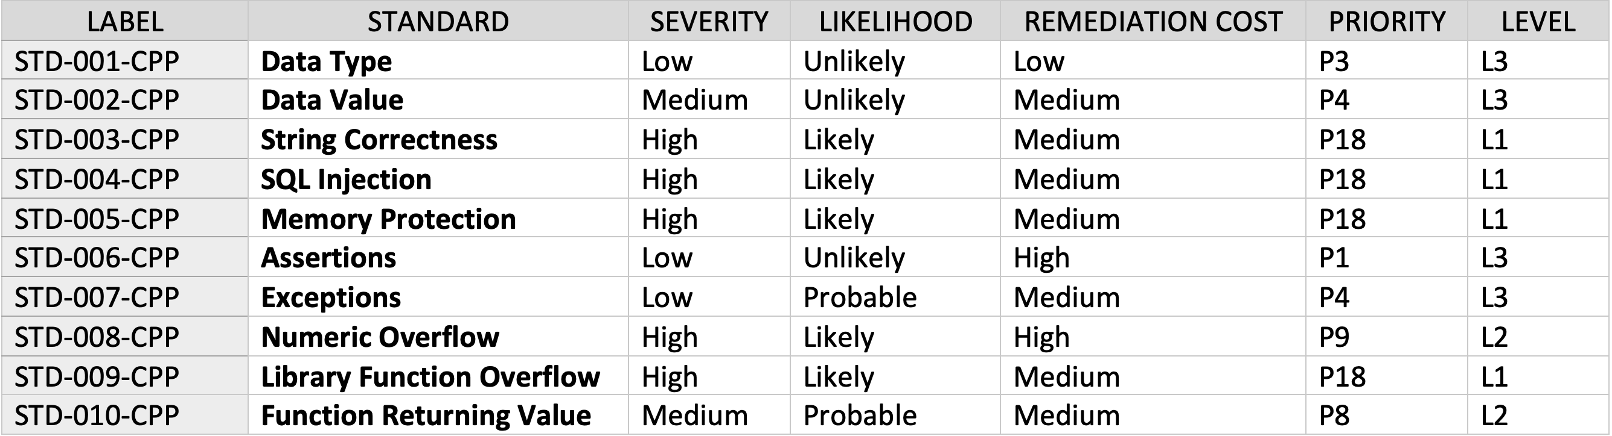
CODING STANDARDS

Slide 6
ENCRYPTION POLICIES
DATA AT REST: Full disk encryption.
DATA IN FLIGHT: Cryptographic protocols, end-to-end encryption.
DATA IN USE: Two-Factor/Multi-Factor Authentication, identity management tools.

Slide 7
TRIPLE-A POLICIES
Authentication: Identify users before permitting system use.
Authorization: Allocate privileges to authenticated users.
Accounting: Monitor the authority and activities of authenticated users.

Slide 8
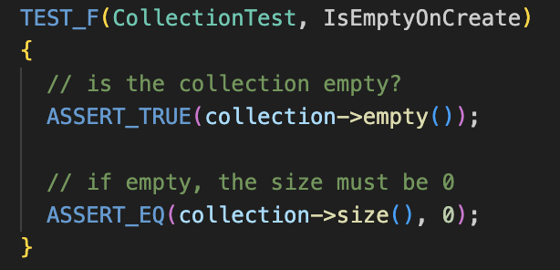
Unit Testing
Google unit tests to enforce standards STD-CPP-002 (Data Value) and STD-CPP-005 (Memory Protection)
Test 1: Verify collection is empty when created.

Slide 9
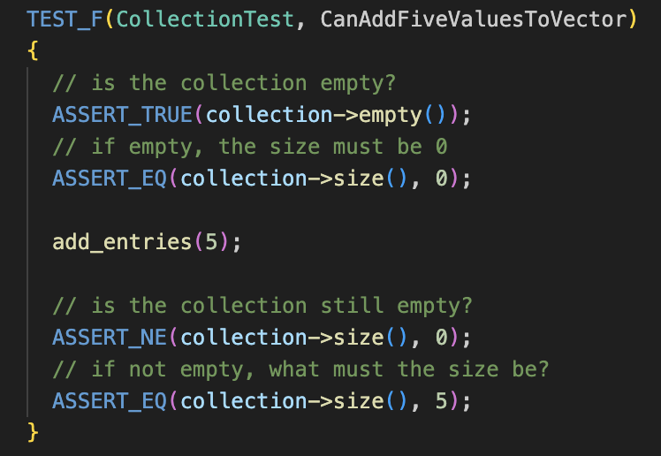
Test 2
Verify that five values can be added to a collection.

Slide 10
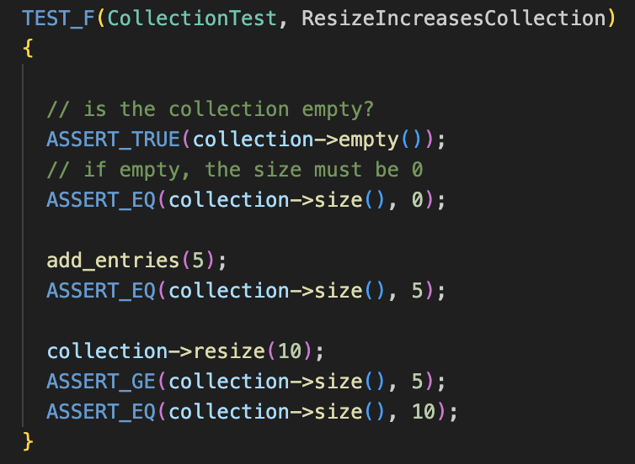
Test 3
Verify that resizing a collection increases the size of the collection.

Slide 11
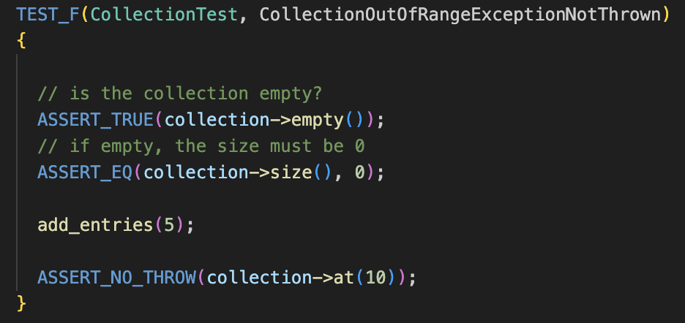
Test 4
Verify that an out-of-range exception is not thrown for accessing an out of bound collection index.

Slide 12

AUTOMATION SUMMARY

Slide 13
TOOLS
Access and Plan:
• DevOps lifecycle tools such as GitLab as Azure DevOps.
• Identity providers and web access management tools.
• Authentication tools.
• Attribute-based access control.
• Privileged account security.
Design and Development:
• OWASP and CERT.
• Static dependency check tools.
Build:
• Build tools such as MS Build, Maven, Gradle.
• Trusted open-source code
• Authentication tools.
Test and Verify:
• Testing tools such as Cucumber, Junit, and Google test.
• DAST and IAST tools such as OWASP ZAP, Veracode and Qualys.
• Fuzzing tools such as Radamsa, AFL, and Burp Suite.
• Vulnerability scanning tools.

Slide 14
RISKS AND BENEFITS
The practice of defense in depth as described in this policy helps to thoroughly secure critical system assets and data.
Not thinking about or implementing security measures from the beginning greatly increases the cost of remediation.
Applying multiple layers of security may be ideal for optimum security but may also impact the number of resources required to implement them.
It also requires the applications to have lots of security dependencies that accrues in licensing costs over time.

Slide 15
RECOMMENDATIONS
Don't Leave Security to the End
Start with security by planning on the kind of data to collect, not collecting sensitive information unnecessarily, and holding on to the data only as long as it is needed.
Control access to data by restricting access and limiting administrative access.
Use secure user authentication schemes such as 2FA/MFA, storing passwords securely, and protecting against authentication bypass.
Properly store, transmit and use sensitive data using encryption.
Regularly audit and track system and network use.
Secure remote access to the system network.
Enforce the use of industry-standard security policies, and train developers in secure coding following the adopted policy.

Slide 16
CONCLUSIONS
Strictly adhere to the practice of defense in depth.
Analyze security impacts using a threat matrix.
Follow clearly defined security principles.
Define detailed standards based on stated principles.
Create policies for data encryption.
Implement of the Triple-A framework
Practice unit testing.
Automate using security tools.

Slide 17
REFERENCES
Seacord R. C. (2013). Secure coding in c and c++ (2nd ed.). Addison-Wesley.
SEI CERT C++ Coding Standard https://wiki.sei.cmu.edu/confluence/pages/viewpage.action?pageId=88046682]

